Slide 1
Rain starts with a consonant – Is quotation part of compositional grammar?
Holden Härtl
Chair of English Linguistics
Faculty of Humanities and Cultural Studies
Universität Kassel

Slide 2
Talking about words
(1) a. “Rain” starts with a consonsant.
b. “Cats” is a noun.
c. “Failure” is just another word for “experience”.
(2) a. Rain starts with a consonsant.
b. Cats is a noun.
c. Failure is just another word for experience.
⇨ Are quotations / quotes part of compositional grammar?
2

Slide 3
Road Map
1 Characteristics of quotation
2 Accounts of pure quotation
3 Experimental studies
4 Conclusion

Slide 4
Characteristics of quotation

Slide 5
Types
Quotation (as an act) is a metalinguistic device used to talk about language
(1) a. “Something is wrong,” Alan whispered softly to his dolls.
b. The coach declared that his team would “kick arse” today.
⇾ direct quotation
⇾ mixed quotation
(2) a. The so-called “hotel” was just an old shed.
b. “Rain” starts with a consonsant.
⇾ scare quotation
⇾ pure quotation
5

Slide 6
Pure quotation
Denotational use
[[ rain ]]
(1) Rain starts with a single drop.
Mentioning use
/ˈreɪn /
[[ “rain” ]]
(2) “Rain” starts with a consonsant.
display linguistic shapes in a rule-like fashion
demonstrate a property of a word type by displaying a word token
6
Cappelen & Lepore (1997); Davidson (1979)

Slide 7
Accounts of pure quotation

Slide 8
Debate
What the accounts debate
A Does a quotational interpretation emerge as part of the compositional derivation of quotational constructions?
Is “rain” syntactically derived from rain?
Are quotes part of syntax (quote morpheme etc.)?
B Or are quotational meanings construed pragmatically?
8

Slide 9
Camp A: Compositional
Claim: Quotation is part of the compositional derivation
Quotation produces truth-conditionally relevant content
(1) a. Kim asked if I was happy.
I = speaker
b. Kim asked, “Am I happy?”.
I = Kim
Quotes are (covertly) present in the underlying syntax
There cannot be quotation without (covert) quotes
9
Cappelen & Lepore (2007); Predelli (2003); Simchen (1999)

Slide 10
Camp A: Compositional
Rabern (2023), for example:
(1) Cicero is human.
[_{S}[_{NP} Cicero ][_{VP} is human]]
(2) “Cicero” is six-lettered.
[_{S}[_{NP}[_{Q} quote][_{N} Cicero]][_{VP} is six-lettered]]
[[ [_{Q} quote] ]] = λc_{s}.λm_{i}. the expression at c ⇒ (for any type i)
S
NP VP
Q N
quote Cicero is six-lettered
10
cf. Partee (1984); Wiślicki (2023)

Slide 11
Camp B: Pragmatic
Claim: Quotations are discourse-generated as communicative acts
Unmarked quotations are not false / ungrammatical
(1) a. Rain starts with a consonsant.
b. Cats is a noun.
c. Failure is just another word for experience.
Quotes
disambiguate between denotational use and mentioning an expression
provide optional ways of signaling a quotation
11
De Brabanter (2023); Saka (2011)

Slide 12
Experimental studies

Slide 13
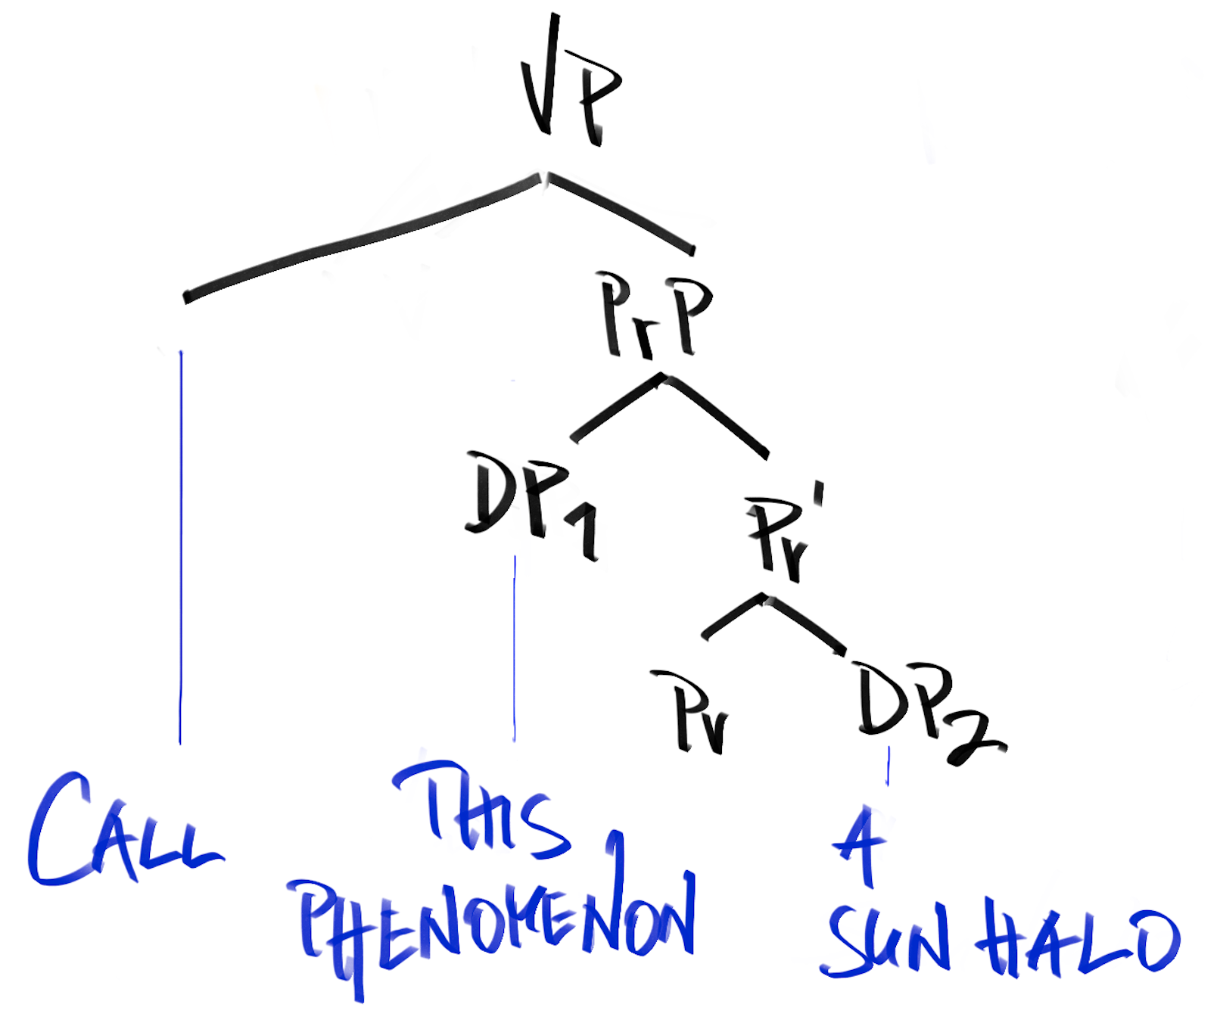
Study 1: Eye tracking
(1) One calls this phenomenon a “Sun halo”.
x call y “n” → y is an n
λP λn λy λx [call(x, y, name(“n”, y)) ˄ P(y, n))]
Small clause: [_{VP} call [_{sc}[this phenomenon] [a “Sun halo”]]]
Object predicative:
dieses Phänomen_{acc} einen „Sonnenring“_{acc} nennen
13
Härtl (2020); Raue & Härtl (2023); Matushansky (2008)

Slide 14
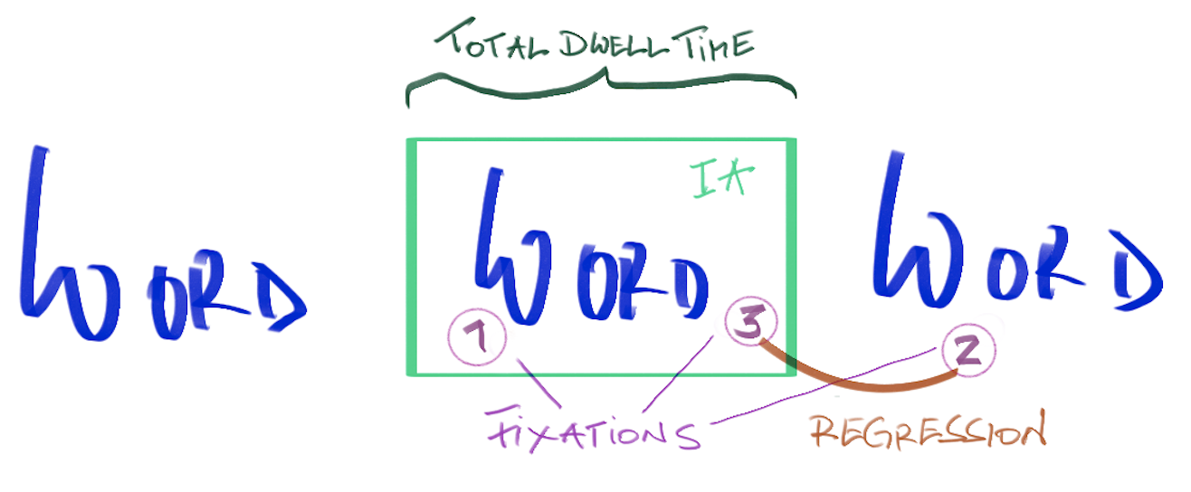
Study 1: Eye tracking
(1) a. … dass man dieses Phänomen „Sonnenring“ nennt …
b. … dass man dieses Phänomen Sonnenring nennt …
Results
No effects for early fixations (1st/2nd fixations) in Interest Area
Effect for total dwell time & regressions (longer/more for words in quotes)
Related to higher, top-down processes → “pragmatic”, discourse-based
14
Orquin & Mueller Loose (2013); Raue & Härtl (2023)

Slide 15
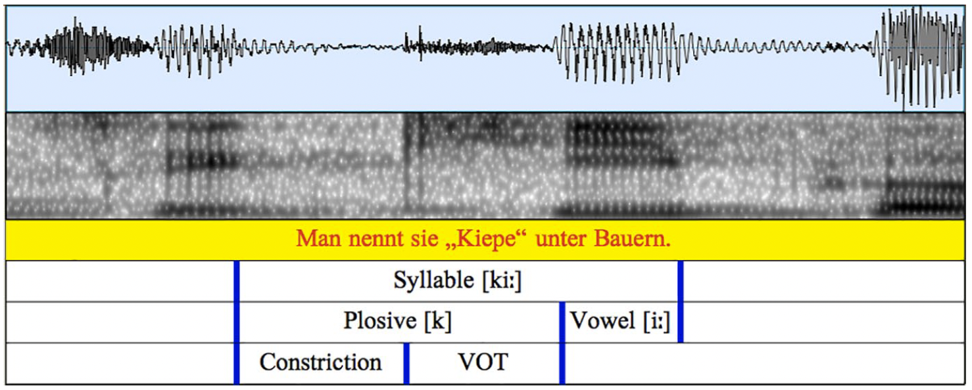
Studies 2a/b: Acoustics
Quotes × Quotational construction
[Pretext]
2a a. … Man nennt sie „Kiepe“ unter Bauern.
b. … Man kennt die „Kiepe“ unter Bauern.
2b a. Viele Mönche tragen die sogenannte „Kutte“ täglich.
b. Viele Mönche tragen die wohlbekannte „Kutte“ täglich.
Results
Lengthening effect for initial plosive of words in quotes (constriction, VOT)
No interaction between quotes and quotational construction
Quotes pronounced only when present → pragmatic account of quotes
15
Härtl (2018); Härtl & Seeliger (2019); Schlechtweg & Härtl (2020)

Slide 16
Study 3: Acoustics
Pure quotation in English
Quotes × Quotational construction
(1) a. Most students recognize that “peace” is a noun.
b. Most students recognize that “peace” is a must.
Results
Lengthening effect for syllable-initial plosive of words in quotes
No interaction between quotes and quotational construction
Quotes pronounced only when present → pragmatic account of quotes
16
Schlechtweg, De Brabanter & Härtl (2023)

Slide 17
Conclusion
Summary
Quotes are articulated regardless of the context type
No articulation of “covert” quotes
No quotational operator in syntax
Quotational meanings emerge pragmatically via discourse (Camp B 🥳)
17

Slide 18
Conclusion
Application
Prescriptive rules for quotation (looser or stricter)
Quotational meanings may be “hard to get” → chatbots, neurodivergent interlocutors
Quoted expressions may be ambiguous → legal & contractual interpretation
Thank you.
18

Slide 19
References
De Brabanter, Philippe. 2023. Quotation does not need marks of quotation. Linguistics, 61-2, 285-316.
Cappelen, Herman & Ernest Lepore. 1997. Varieties of quotation. Mind 106-423, 429-450.
Cappelen, Herman & Ernest Lepore. 2007. Language turned on itself: The semantics and pragmatics of metalinguistic discourse. Oxford: Oxford University Press.
Davidson, Donald. 1979. Quotation. Theory and Decision 11, 27-40.
Härtl, Holden. 2018. Name-informing and distancing ‘sogenannt’ (‘so-called’): Name mentioning and the lexicon-pragmatics interface. Zeitschrift für Sprachwissenschaft 37-2, 139-169.
Härtl, Holden. 2020. Referring nouns in name-informing quotation: A copula-based approach. In: Michael Franke, Nikola Kompa, Mingya Liu, Jutta L. Mueller & Juliane Schwab (eds.) Proceedings of Sinn und Bedeutung 24 - Vol. 1. U Osnabrück / HU Berlin, 291-304.
Härtl, Holden & Heiko Seeliger. 2019. Is a so-called “beach” a beach? An empirically based analysis of secondary content induced by ironic name use. In: Daniel Gutzmann & Katharina Turgay (eds.) Secondary Content - The Semantics and Pragmatics of Side Issues (= Current Research in the Semantics / Pragmatics Interface series 37). Leiden: Brill, 200-221.
Matushansky, Ora. 2008. On the linguistic complexity of proper names. Linguistics and Philosophy 31-5, 573-627.
Partee, Barbara. 1984. The syntax and semantics of quotation. In: Stephen R. Anderson & Paul Kiparsky (eds.) A Festschrift for Morris Halle. New York: Holt, Reinehart and Winston, 410-418.
Orquin, Jacob & Mueller Loose, Simone. 2013. Attention and choice: A review on eye movements in decision making. Acta Psychologica 144, 190–206.
Predelli, Stefano. 2003. Scare quotes and their relation to other semantic issues. Linguistics and Philosophy 26-1, 1-28.
​Schlechtweg, Marcel & Holden Härtl (2020) Do we pronounce quotation? An analysis of name-informing and non-name-informing contexts. Language and Speech 63-4, 769-798.
Schlechtweg, Marcel & Holden Härtl. 2023. Quotation marks and the processing of irony in English: Evidence from a reading time study. Linguistics 61-2, 355-390.
Schlechtweg, Marcel, Philippe De Brabanter & Holden Härtl. 2023. The acoustic profile of English metalinguistic quotation. To appear in: Marcel Schlechtweg (ed.) Interfaces of Phonetics (= Phonology and Phonetics series). Berlin: De Gruyter Mouton.
Simchen, Ori. 1999. Quotational mixing of use and mention. The Philosophical Quarterly 49-196. 325-336.
Rabern, Brian. 2023. Pure quotation in linguistic context. Journal of Philosophical Logic 52, 393-413.
Raue, Natascha & Holden Härtl. 2023. Quotation marks and their processing: evidence from eye tracking data", Accepted as Poster Presentation at ELPC2023 (Eye-tracking and Language Processing Conference), Athens, December 2023.
Saka, Paul. 2011. The act of quotation. In: Elke Brendel, Jörg Meibauer & Markus Steinbach (eds.) Understanding quotation, Berlin & New York: De Gruyter Mouton, 303–322.
Wiślicki, Jan. 2023. Scare quotes as deontic modals. Linguistics 61-2, 417-457.

